Slide 1
Sentiment analysis

Slide 2
Sentiment analysis involves classifying comments or opinions in text into categories such as "positive" or "negative" often with an implicit category of "neutral".
A classic sentiment application would be tracking what people think about different topics.
Sentiment analysis in data science and machine learning is also called "opinion mining" or in marketing terminology "voice of the customer". It can be a very useful tool to check the affinity to brands, products, or

Slide 3
Sentiment analysis also has its limitations and is not to be used as a 100% accurate marker.
As natural language can be very ambiguous with multiple connotations, it's hard if not impossible for machines and algorithms to detect them all. Sentiment analysis basically analyses patterns of words in phrases that are more likely to be positive, negative, or neutral, finally, giving a score on each. This approach is quite effective, but not always accurate on informal language.
For example, in the context of coffee, "hot" or "cold" is neutral, but in the context of people "hot" or "cold" can be positive or negative.

Slide 4
Sentiment analysis is essentially a classification problem in machine learning
classification is a mathematical model to classify the tweets into certain categories and it relies on labeled datasets.
In our case, the categories will be defined as "positive", "negative", and "neutral".
A labeled dataset, also called the training dataset, is a sample of data that is manually tagged with the sentiment from human understanding.
Based on these labels of the training dataset, the classifier learns the patterns for positive, negative, and neutral content that it applies then to the actual or UFTU dataset

Slide 5
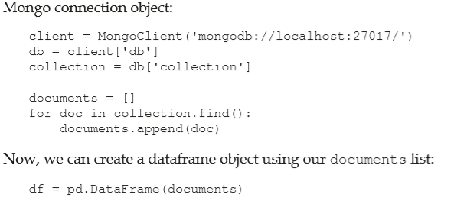
Data pull

Slide 6
Data cleaning
The process consists of three steps:
1.Text tokenization.
2.Stopwords removal.
3.Special characters removal.

Slide 7
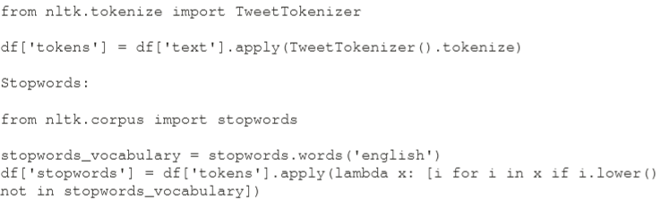
Tokenization

Slide 8
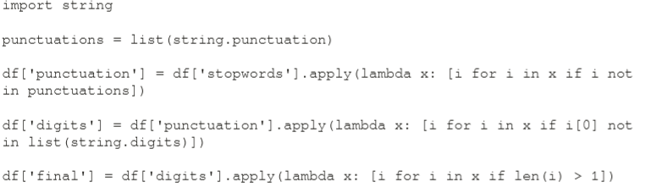
Special characters and stopwords

Slide 9

the classifiers return the probability that a tweet belongs to a category:
tweet_text : { positive: 0.7 , neutral: 0.2 , negative : 0.1 }
For our analysis, we will use a pre-trained model from the NLTK library
For our sentiment analysis, we chose a sentiment analyzer called VADER (Valence Aware Dictionary for Sentiment Reasoning), which is available with Python's NLTK library as follows:

Slide 10
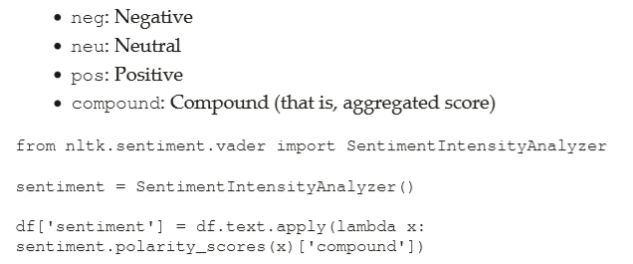
The VADER algorithm outputs sentiment scores to four classes of sentiments:

Slide 11
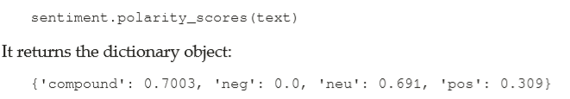
compound value is a normalized score of all three categories with a value range between -1 and 1.

Slide 12
Customized sentiment analysis
the quality and the type of the training data have a big impact on the classifier's performance.
Most pre-trained classifiers (like VADER) are trained on general texts because they are designed to be versatile for use on different topics. Unfortunately, when we need to extract sentiment from a specific textual data (for example, very domain specific) such as a general classifier might not perform very well.
That is why, it makes great sense to train our own classifier that will fit specific needs, or alternately, just train a general classifier, but based on customized, verified, and known datasets.
There are many sources of datasets available on the internet free of charge, but in extreme cases, we can also prepare our own.

Slide 13
The preparation of a custom classifier requires two data sets:
Training data set: The data on which the classifier algorithm learns the model parameters
Test data set: This is used to determine the accuracy of the algorithm
In order to create custom-made classifiers for sentiment analysis, we will use the Python scikit-learn library.
The library features multiple machine learning algorithms, among which, we will find regression, classification, or clustering implementations
To begin, we will import a few elements from the library:

Slide 14
TfidfVectorizer is needed for transforming our data into numerical features usable for the model. It means the text will be represented as numerical data.
Naive Bayes classifier is a simple, yet powerful technique, thus very popular in many prototyping cases which is based on Bayes Theorem.
This machine learning technique is often used for simple classification tasks such as spam or document classification. It is also a very suitable algorithm for our "bag of words" approach to sentiment classification
In the next step, we import all necessary libraries for evaluating the performance of a model :

Slide 15
Labeling the data
As explained in the previous section, we have to manually label a training dataset.
a person who labels the data is able to do it correctly. In order to store the labels, we create a column “label”, which associates a class with a tweet.
The general rule is that the more labeled data the better, but labeling is a costly operation.
In order to be efficient we label only observations that are clearly associated with a class. It will help us to get only the best examples of positive, neutral, and negative sentiment. As a result, the algorithm should have a good performance in predicting the most insightful tweets in terms of sentiment, which is the objective.

Slide 16
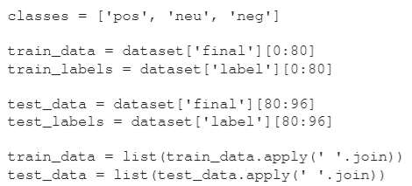
We create 96 balanced labels, which means that we have around 33% of rows related to each class:

Slide 17
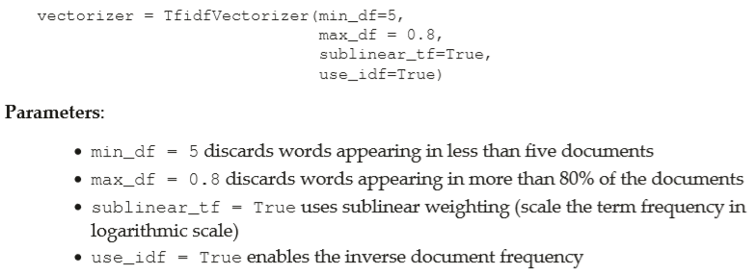
Creating the model

Slide 18
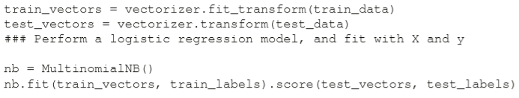
As a result, we obtain, train, and test vectors that can be directly used to train and validate models :

Slide 19
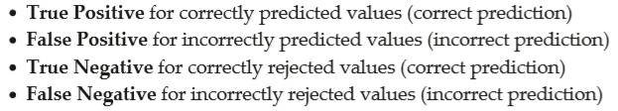
Confusion matrix
A confusion matrix is a technique for summarizing the performance of a classification algorithm.
we have to select specific outcome from observations and define it as a base case (for example, it rains versus alternative (rejected) no rain). It becomes a reference point for evaluating our model with the test data.

Slide 20



Precision is defined as the proportion of positive predictions to the number of observations that are actually positive.
Recall tells us what is the proportion of actually positive observations predicted as positive
F1-score combines precision and recall to measure the test accuracy. It can be interpreted as weighted average of precision and recall with its best value at 1 and the worst at 0

Slide 21
